Slide 1
Methodologies & Closing
Week 6 Project Management

Slide 2
Agenda
Agile & Scrum Fundamentals
Kanban & Lean Project Management
Change & Configuration Management
Leadership & Stakeholder Engagement
Simulated Project Delivery & Retrospective
Muhammad Fahad Bashir

Slide 3
Agile & Scrum Fundamentals
Scrum is an Agile methodology that breaks down the work into timeboxed sprints (e.g., 1–2 weeks) with structured meetings and team roles.
Scrum Roles
Role | Responsibility
Product Owner | Manages product vision & backlog
Scrum Master | Facilitates the process and removes blockers
Development Team | Builds the product increment

Slide 4
Scrum Ceremonies
Ceremony | Purpose
Sprint Planning | Plan what to do in the sprint
Daily Standup | 15-min team check-in
Sprint Review | Demo the work done
Retrospective | Discuss what went well, what to improve

Slide 5
Task (Food Delivery )
Step | Task
Create Scrum Board | JIRA → Create Project → Scrum Template
Add Epics → Stories → Tasks | Use login, browse restaurants, place order
Create Sprint 1 | Drag stories to Sprint and start
Track progress | Move tasks across To Do → In Progress → Done
Hold mock standup | Ask “What did you do? What’s next? Any blockers?”

Slide 6
Kanban & Lean Project Management
Kanban focuses on continuous delivery with a visual board and WIP (Work-In-Progress) limits. No fixed sprints, no estimates — just smooth flow.Kanban focuses on continuous delivery with a visual board and WIP (Work-In-Progress) limits. No fixed sprints, no estimates — just smooth flow.
Feature | Scrum | Kanban
Timeboxed | Yes (Sprints) | No (Continuous)
Roles | Defined | Flexible
WIP Limits | Optional | Required
Estimation | Story points / hours | Optional
Delivery | At end of sprint | Anytime when task is done

Slide 7
When to use which ?
"Scrum helps you deliver structured, sprint-based progress.Kanban helps you stay lean and flow-driven with fast delivery.“
In real projects, most teams use a mix of both depending on their needs.

Slide 8
Change & Configuration Management
Handle changes smartly. Keep everything versioned, traceable, and under control.
Change Management is the process of controlling and documenting changes to project scope, requirements, features, or files.
Why It Matters:
Keeps the team on the same page
Avoids surprises for developers/testers
Helps stakeholders approve changes formally

Slide 9
Configuration Management?
Configuration Management ensures that all versions of project artifacts (code, docs, test cases) are tracked and reproducible.
🎯 Why It Matters:
Avoids “it worked on my machine” issues
Helps rollback to previous versions
Enables CI/CD and deployment automation

Slide 10
Example
Scenario | Change Mgmt | Config Mgmt
User wants to add search bar in restaurant list | Create new JIRA issue, review & approve | Create new branch in Git, tag release
Found bug in checkout logic | Log bug in JIRA | Fix code in repo and link commit to JIRA
Deployment failed due to config mismatch | Use environment version tracking | Store .env in Git with proper versioning

Slide 11
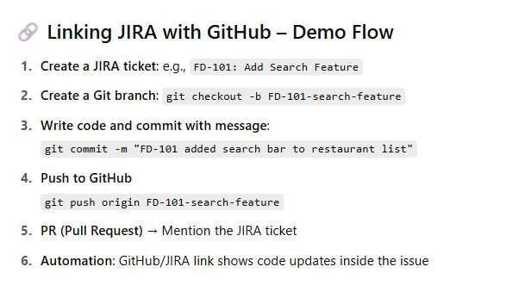
Tools & Linking
Tool | Use
JIRA | Track feature/bug change requests
Git + GitHub | Code version control
GitHub Actions | Automate testing, build, deployment
Git Tags | Mark versions/releases
Branches | Separate dev/test/main code flows

Slide 12
Leadership & Stakeholder Engagement
It shifts the focus from tasks and tools to people and communication, which is where true project success lies.
Lead your team, resolve issues, and keep stakeholders updated & confident.

Slide 13
Project Leadership?
Leadership in project management means inspiring your team, solving conflicts, making decisions, and creating a healthy delivery environment.
As a PM, you must:
Motivate your team members
Set clear goals and priorities
Unblock issues and prevent delays
Encourage collaboration and respect
🎯 Example (Food App): Ali (backend dev) and Fatima (UI) disagree on the design layout. ☑️ You jump in, align both on priorities, and facilitate compromise.

Slide 14
Team Management Best Practices
Skill | Example
Clear Communication | Daily standups, well-written tickets
Delegation | Assign tasks based on skill, not just availability
Empathy | Check-in when someone is stuck or stressed
Conflict Resolution | 1:1 chats, not public blame
Feedback | Give constructive, timely feedback

Slide 15
Stakeholder Engagement
Stakeholders = anyone who has interest or influence in the project (client, customer, manager, investor, etc.)
🎯 Your goal: Keep them informed, involved, and confident — without overwhelming them.
Method | Tool | What It Shows
📈 Dashboard | JIRA Dashboard | Progress of Sprints, Tasks, Bugs
📬 Weekly Report | Google Doc / Notion | What’s done, what’s next, blockers
📣 Email Update | Email/Slack | Key decisions, releases, risks
🔔 Notifications | JIRA Automation | Auto emails when task status changes

Slide 16
Tools don’t lead projects. People do.

Slide 17
Simulated Project Delivery & Retrospective
Objective: Deliver your MVP, review the sprint, and evaluate your team’s performance — just like in a real agile company.

Slide 18
What is a Sprint Review?
A Sprint Review is a live demo where the team shows the stakeholders what features were completed — and gets feedback.

Slide 19
What is a Sprint Retrospective?
A Retrospective is a team meeting where you reflect on:
What went well
What could have gone better
What should be improved
Went Well | Didn't Go Well | Improvements
Fast UI delivery | Delays in API testing | More buffer time for testing
Clear communication | Missed a daily standup | Use JIRA reminders
Smooth Git workflow | Rework due to unclear stories | Better user story detail

Slide 20
Generate Performance Reports
Go to Reports → Generate:
Sprint Report: What was planned vs. done
Velocity Chart: Measure story points completed per sprint
Burndown Chart: Visualize progress over time
Export or present screenshots of:
Tasks done vs. remaining
Bugs found vs. resolved
Completion rate

Slide 21
“Delivery is not just pushing code — it’s about showing value, learning from what went wrong, and preparing smarter for what’s next.”

